Slide 1
NETW191 Course Project Module 3 Connectivity Test

Slide 2
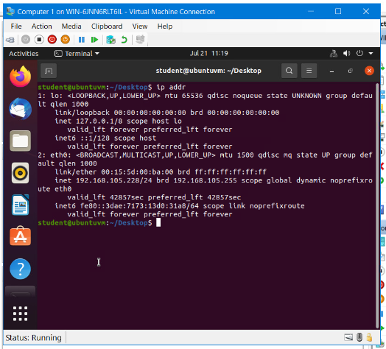
Dynamic IP Address Assignment
This screenshot should show the IPv4 address of the Computer 1 VM.

Slide 3
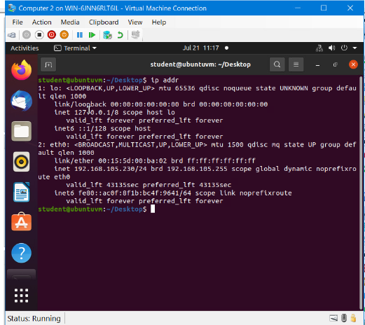
Dynamic IP Address Assignment
This screenshot should show the IPv4 address of the Computer 2 VM.

Slide 4
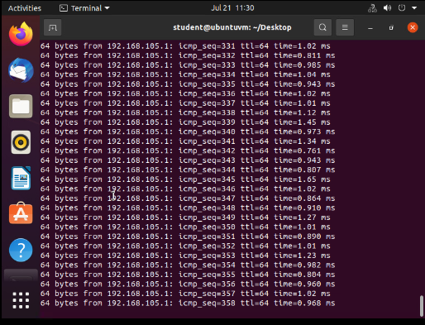
Connectivity Test
This screenshot should show the connectivity tests between the Computer 1 VM and the other two devices (i.e., the SOHO Router VM and Computer 2 VM).

Slide 5
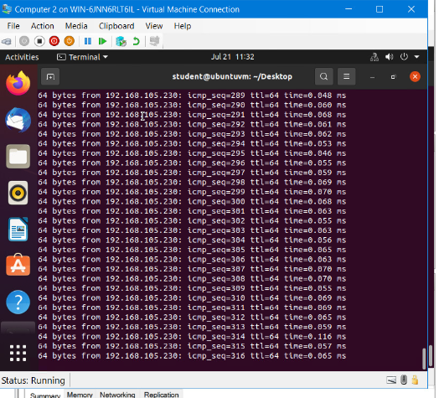
Connectivity Test
This screenshot should show the connectivity tests between the Computer 2 VM and the other two devices (i.e., the SOHO Router VM and Computer 1 VM).

